Slide 1

Designing the Optimal Lineup in English Premier League Football
Derek Caramella & Miguel Novo Villar
02 December 2021
Notes:
Introduction Slide.
Miguel introduces himself.
Derek introduces himself.
Miguel directs audience to the handout that has a QR code linking the presentation to the web as a reference.

Slide 2
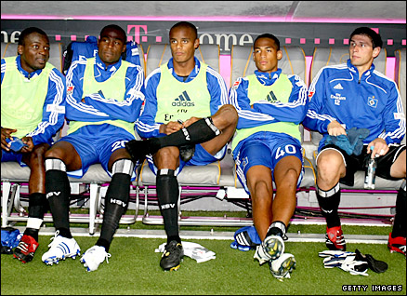
Why do Managers Care About Team Composition?
Wage Capital Scarcity
Transfer Windows & Deadlines
Dodging relegation is top priority
Who do I buy?
Who do I play?
What combination of player types perform successfully?
Notes:
A slide to capture interest.
Wage Capital Scarcity: Introduce the budget constraint & why it is a concern
Transfer Windows & Deadlines: Clubs cannot buy players at any time, designated time intervals exist for transfers
Relegation occurs when a club is in the Top Division, but losses so many times that they get relegated down to the lower division
Lastly, propose questions for research and explanation

Slide 3
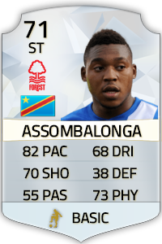
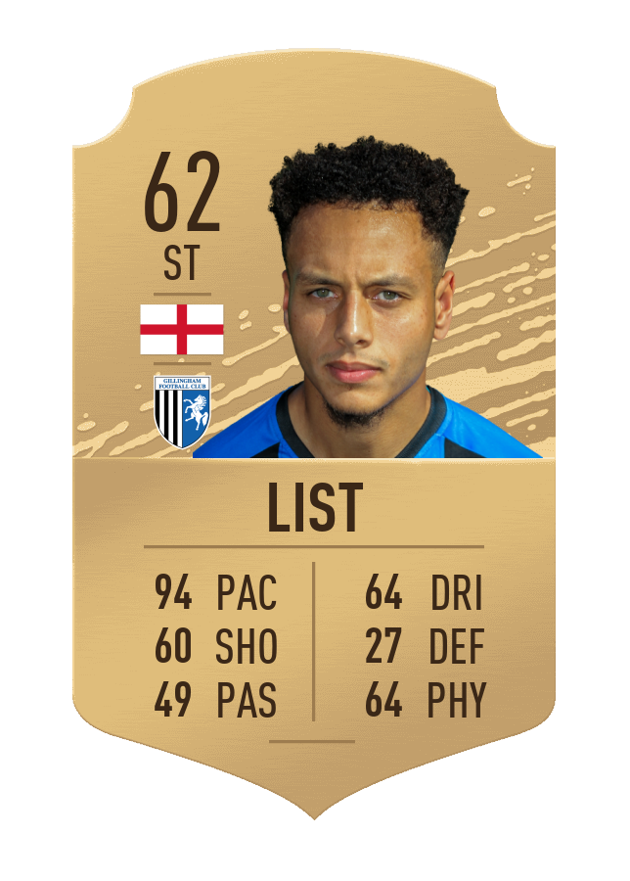
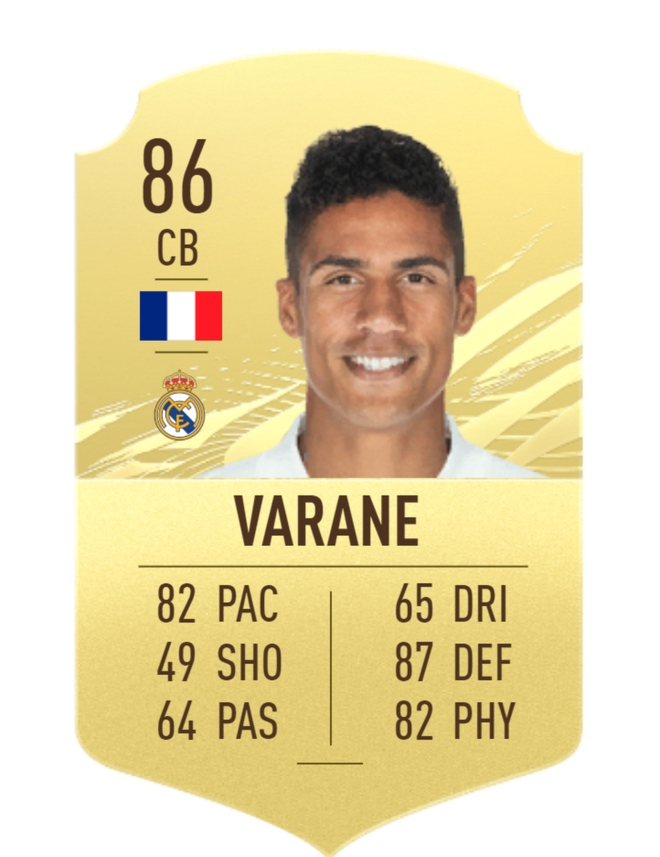
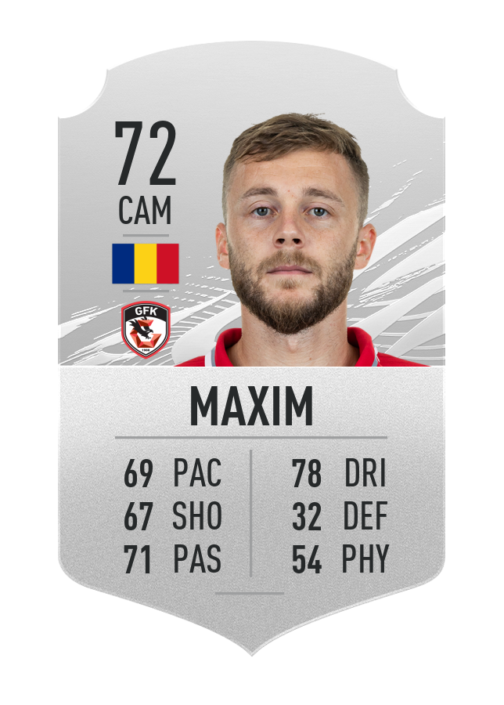
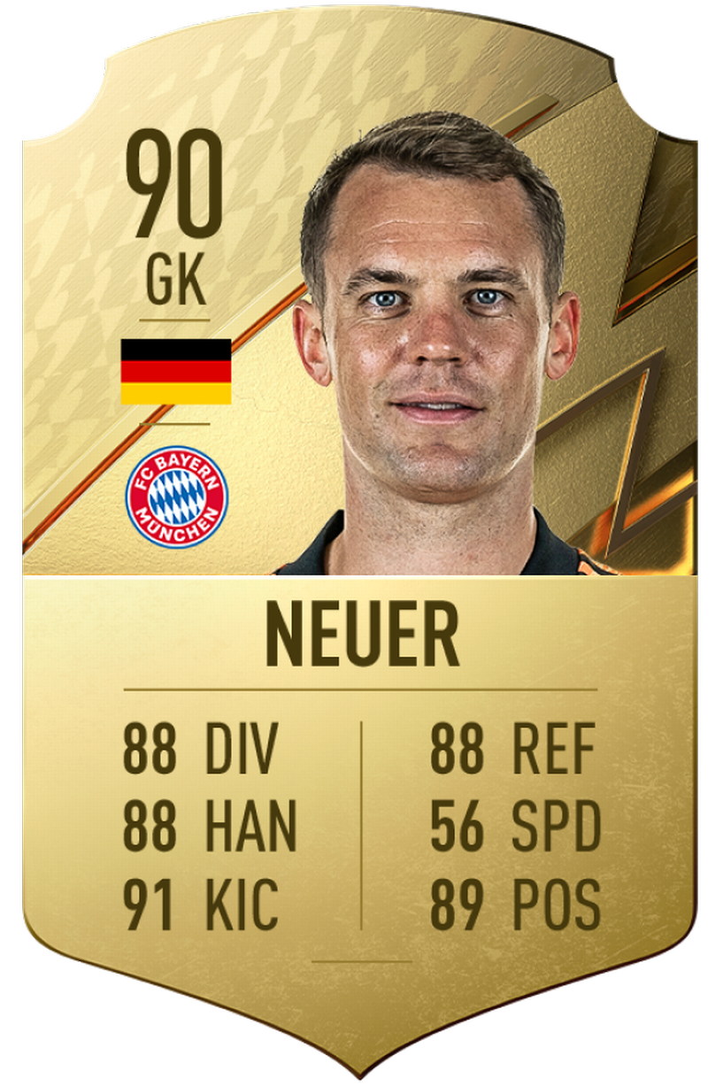
Why do Managers Care About Team Composition?
Wage Capital Scarcity
Transfer Windows & Deadlines
Dodging relegation is top priority
Who do I buy?
Who do I play?
What combination of player types perform successfully?
Notes:
The manager is not only looking at a player, but they are also looking at position, skills, and capabilities – a slide that depicts this occurring

Slide 4
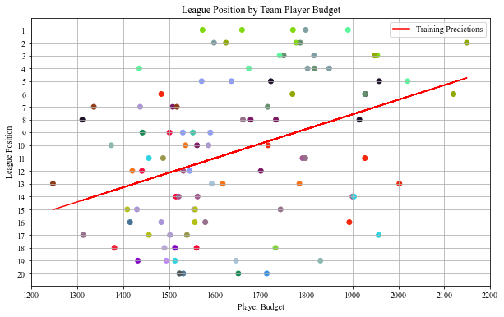
Does Money Impact League Position?
Yes
Ridge Regression
As wage capital expenses increase, a club, on average, performs better
From 2016-2017 to 2020-2021 season
Each color represents a team throughout the time interval
Notes:
A Linear Ridge Regression exhibiting that as the wage budget increases, the higher the league position.
The data set comes from the 2016-207 to 2020-2021 seasons
A team can be repeated in the time interval, but the club is represented with the same color
Although the general trend is evident, some outliers exist such as the 4th place with roughly 1,450 budget

Slide 5
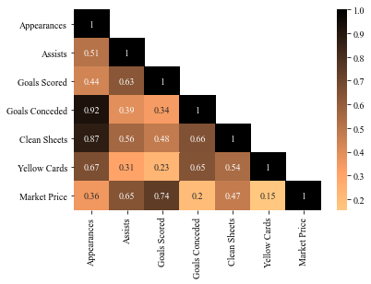
What Features Determine a Player Tier?
Market price correlated with assists & goals scored
Goals conceded, clean sheets, & yellow cards are correlated with appearances
Notes:
Correlation matrix exhibiting the relationship between features

Slide 6
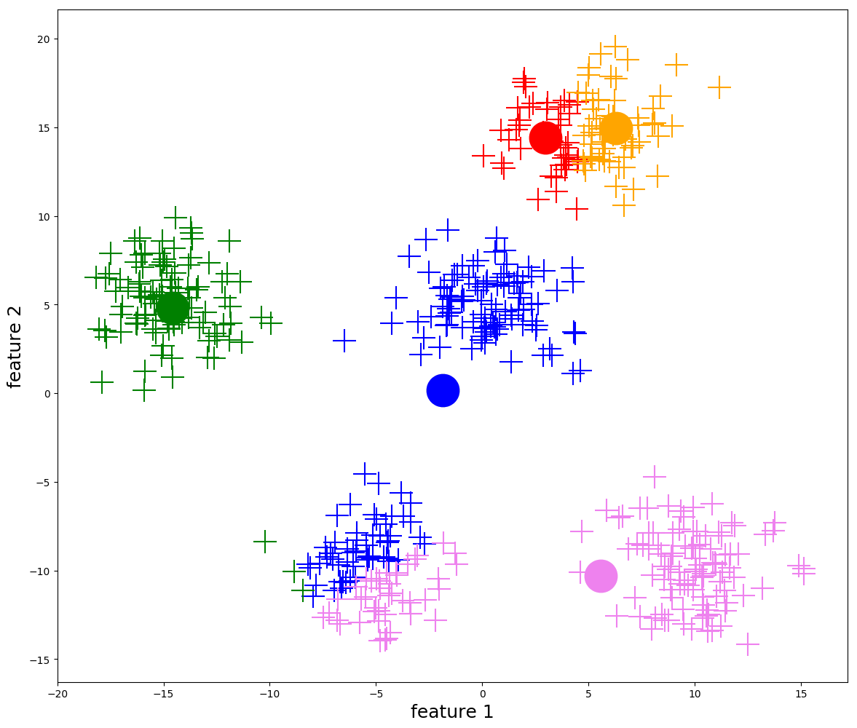

How to Identify Player Type?
K-means++ Clustering
Centroid Based Clustering
Initialize by choosing a random centroid, then identify other centroids by maximizing the distance between clusters
Iteratively calculate the mean of the cluster, then adjust the centroid until the mean is constant across iterations
Higher quality results: initialization dispersed across the domain relative to a randomized initialization of a vanilla k-means algorithm
Features:
Appearances
Assists
Goals scored
Goals conceded
Clean sheets
Yellow cards
Market Value
Three Clusters
Gold, Silver, & Bronze tiers
Notes:
Describe the k-means++ clustering algorithm
Outline the clustering features
We cluster the players to conduct frequent itemset analysis at a less granular level
We partitioned the dataset by season & position
One season gold tier forward may not be a gold tier forward in another season due to league bolstering
We split by position because the raw features do not separate the positions; therefore, we partitioned by position before clustering

Slide 7
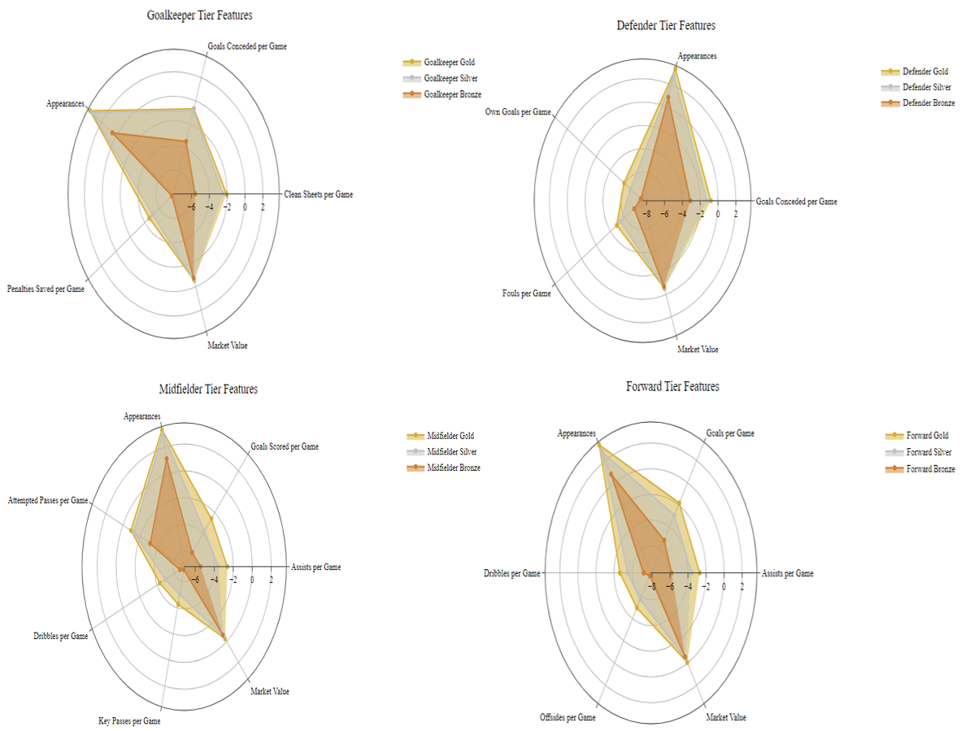
How to Correct for Season & Position?
Partition Data Set by Season
Game Progression
Off Season Transfers
League Bolstering
Partition Data Set by Position
Notes:
Radar plots (axis natural log), for each position we consider applicable features
The results confirm that gold overcomes silver and silver overcomes bronze, in each position.

Slide 8
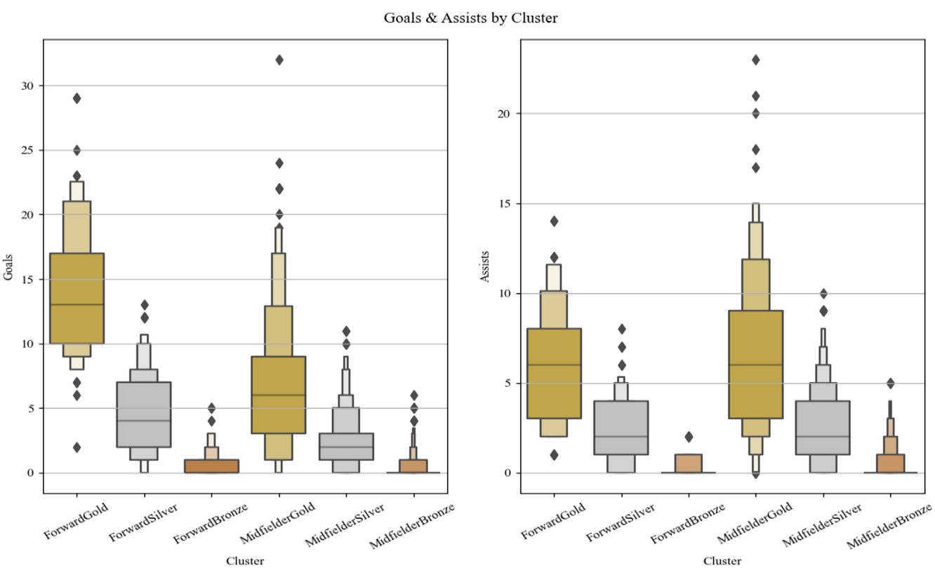
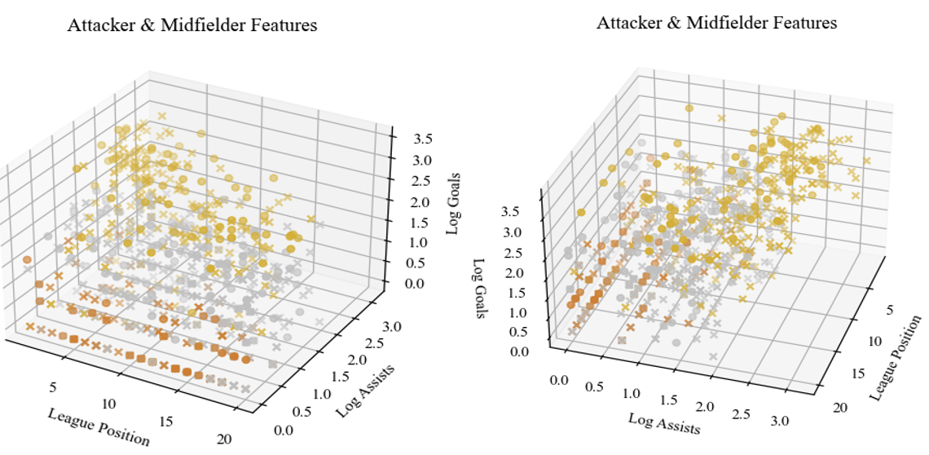
Are Forwards & Midfielders Similar?
x represents midfielders & o exhibits forwards
Key Findings:
Upper tier Gold Midfielder contribute the same expected goal count as a Gold Forward
Forwards rarely contribute the number of assists midfielders provide
All teams possess Bronze players regardless of league position
Notes:
Boxenplot & 3D plot analysis
Upper tier Gold Midfielder contribute the same expected goal count as a Gold Forward
Forwards rarely contribute the number of assists midfielders provide
All teams possess Bronze players regardless of league position

Slide 9
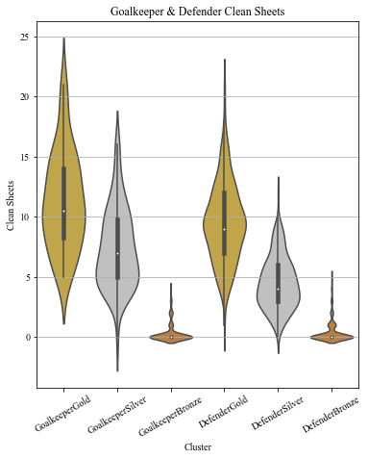
Are Goalkeepers & Defenders Similar?
Gold Goalkeepers outperform Gold Defenders
Gold Goalkeepers are scarcer than Gold Defenders
Silver Goalkeepers outperform Silver Defenders
Bronze Goalkeepers & Defenders contribute roughly congruent clean sheets
Notes:
Violin plots comparing goalkeeper & defender tiers

Slide 10
What Separates Top-Flight & Relegation Class Clubs?
Team Composition & Tactics
Frequent itemset analysis (Apriori) to identify frequent player combinations amongst Top-Flight clubs & Relegation Class Clubs
Project data set into two sets: The top 25% of teams & bottom 25% of teams
For each partition, consider each game week as a transaction
{GoalkeeperGold1, DefenderBronze1, DefenderSilver2, DefenderGold1, MidfielderGold4, MidfielderSilver3, ForwardGold2}
Top-Flight Clubs
{DefenderGold2, MidfielderGold1}
Relegation Class Clubs
{DefenderSilver1}
{DefenderGold1, MidfielderSilver1, MidfielderGold1}
{DefenderGold1, MidfielderSilver1, MidfielderGold2}
{DefenderGold1, MidfielderSilver2}
{MidfielderGold1, MidfielderSilver2}
Notes:
Apriori minimum support = 0.75

Slide 11
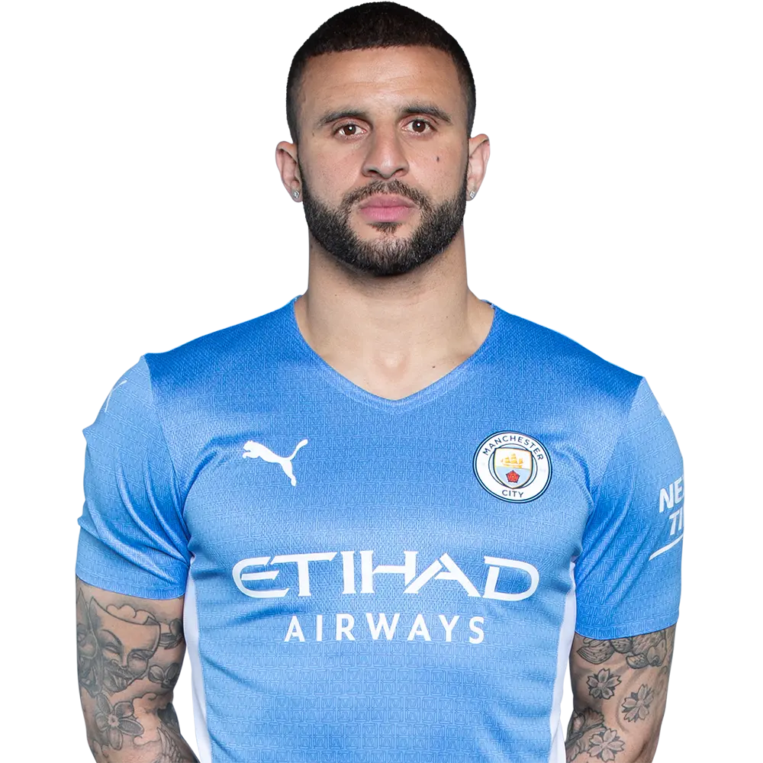
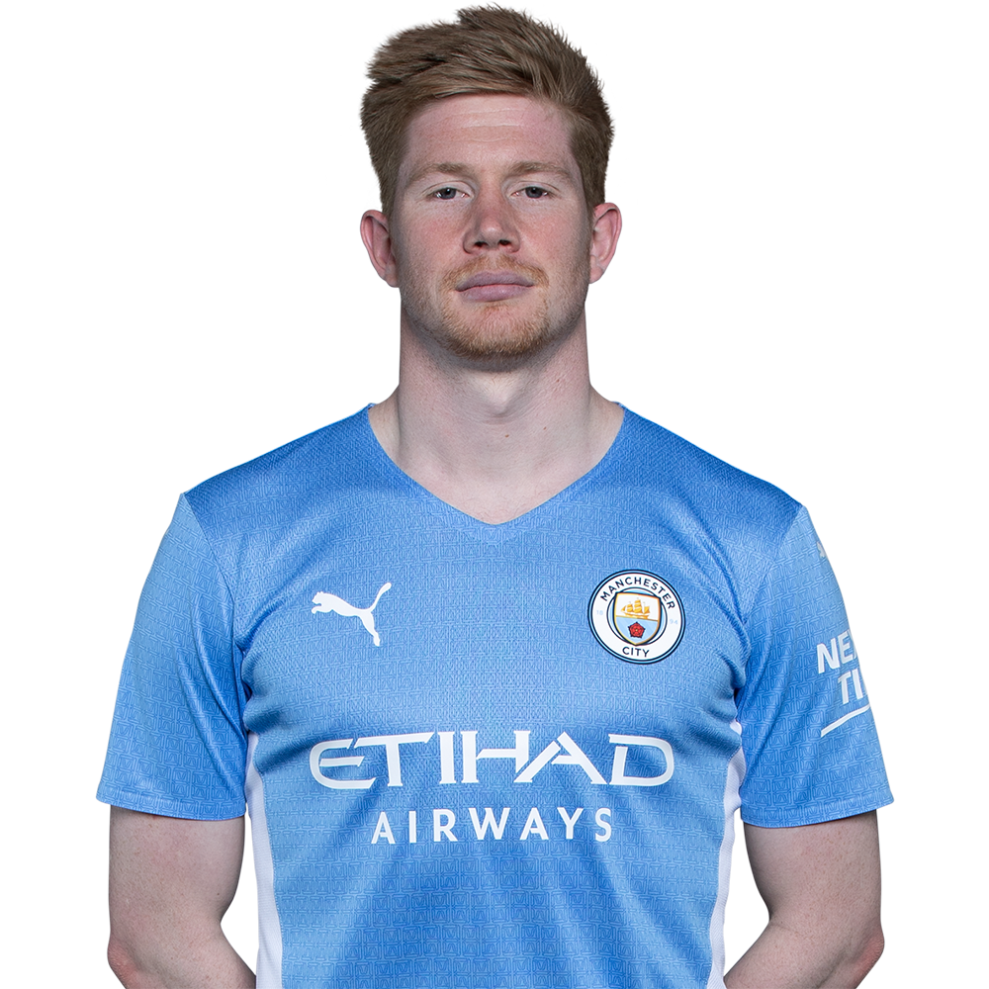
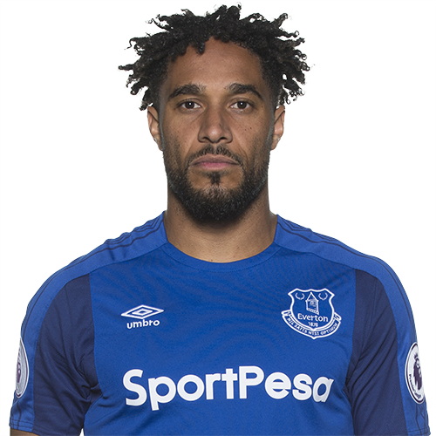
How Do Top-Flight & Relegation Clubs Play?
Top-Flight Clubs
Relegation Class Clubs
Offense transitions
Defense transitions
Establish offensive presence
Heavy emphasis on possession
Gold tier wingback defenders to maintain possession & deliver crosses
Gold tier midfielders to serve a strong, resilient forward
Establish defensive presence
Heavy emphasis on gold tier center back
Keep shots away from the middle
Attempt to score on counter attacks & mistakes
Notes:
Offense Transition: When the ball is won by the defending team, the team performs efficiently to transition to offense
Defense Transition: When the ball is lost by the attacking team, the team performs efficiently to transition to defense
Wingbacks play defense and offense regularly. They focus on possession management & offer additional support to the midfield
Center-backs are free to join the attack, but rarely do because it exposes the middle of the pitch. Therefore, defending teams focus on defending

Slide 12
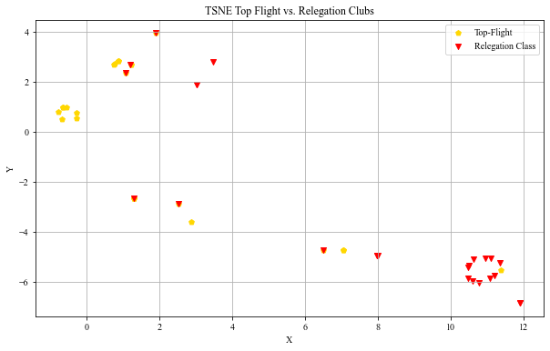
How Similar are Top-Flight & Relegation Class Clubs?
One-Hot Encoding
An array determining the frequent itemsets present in the club
T-SNE
t-Distributed Stochastic Neighborhood Embedding
Non-Linear Dimensionality Reduction
Preserve Local Structure
Handles Outliers
Results
Two distinct groups containing Top-Flight and Relegation Class clubs
Sporadic relegation class clusters
Sometimes Relegation Class clubs contain the correct player type combinations, but cannot get it done
Notes:
One Hot Encoding
All frequent itemsets become features, then each club is represented by an array to show the presence or absence of the frequent itemsets
We selected t-SNE over PCA to preserve local structure

Slide 13

What are the Key Points?
Invest in a strong gold tiered midfield accompanied by at least one strong wing back
Tactically focus on transitional moments relative to establishing defense
Above average Gold Midfielders score the expected value of Gold Forwards & provide more assists
Gold Midfielders reap the highest return on capital investment
Ensure tactics conform to the player combinations to generate fortunate results
Notes:
Summarize key findings

Slide 14

What’s Next?
Similar analysis with La Liga
Various formations with frequent itemsets
Possession & passing decision during attack buildup
Notes:
Similar analysis with La Liga
We expect heavier emphasis on forwards, due to different playing styles
Various formations with frequent itemsets
How do formations effect the player line-up? Incorporating various formations into the model will uncover the best way to orient a club to be successful.
Possession & passing decision during attack buildup
Find frequent passing patterns to maintain possession & score goals

Slide 15

Questions?

Slide 16
References
[1] Gangal, A., Talnikar, A., Dalvi, A., Zope, V., & Kulkarni, A. (2015). Analysis and Prediction of Football Statistics using Data Mining Techniques. International Journal of Computer Applications, 132(5), 8-11.
[2] Bloomfield, J., Polman, R., & O'Donoghue, P. (2007). Physical Demands of Different Positions in FA Premier League Soccer. Journal of sports science & medicine, 6(1), 63–70.
[3] Gollan, Stuart & Bellenger, Clint & Norton, Kevin. (2020). Contextual Factors Impact Styles of Play in the English Premier League. Journal of sports science & medicine. 19. 78 - 83.
[4] Anand, V. (2020, September 31). Cleaned players [Data set]. Retrieved from https://github.com
/vaastav/Fantasy-Premier-League/blob/master/data/2021-22/cleaned_players.csv
[5] Cay, A. (2021, May 12). Hindsight optimization for FPL. Alpa Code. Retrieved from https://alps
code.com/blog/hindsight-optimization/
[6] Ge, T., An, Z., Cai, H., & Wang, Y. (2020, August). An analysis on the effectiveness of cooperation in a soccer team. 2020 15th International Conference on Computer Science & Education (ICCSE) 787-794.
[7] Perera, D., Kay, J., Koprinska, I., Yacef, K., & Zaïane, O. R. (2008). Clustering and sequential
pattern mining of online collaborative learning data. IEEE Transactions on Knowledge
and Data Engineering, 21(6), 759-772.
[8] Sæbø, O. D., & Hvattum, L. M. (2019). Modelling the financial contribution of soccer players to their clubs. Journal of Sports Analytics, 5(1), 23-34.
[9] F. Perez-Cruz, “Kullback-Leibler divergence estimation of continuous distributions,” 2008 IEEE international Symposium on Information Theory, 2008, pp. 1666-1670, doi: 10.1109/ISIT.2008.4595271.

